Slide 1
Break Out Unit 12

Slide 2
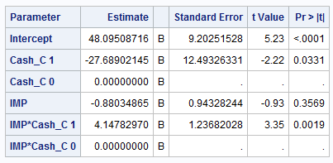
Breakout 1
Write two equations for the regression of Charity on Importance … one for each value of Cash_C.
Cash_C:
0: <= $45,000
1: > $45,000

Slide 3
Breakout 2

Slide 4
HSB2!
We would like to create a model with a categorical variable for socioeconomic status (SES) in order to test if there is a difference in mean science score for changes between SES = 3 to SES = 1 and SES = 3 to SES =2, taking the math score into account. (Assume math is associated with the science score in the same way for each SES.) Can we quantify these amounts? That is, by how much can we expect the science score to increase or decrease with respect to SES = 3 (make SES = 3 the reference level). Be sure and write out the model statement and check assumptions!

Slide 5
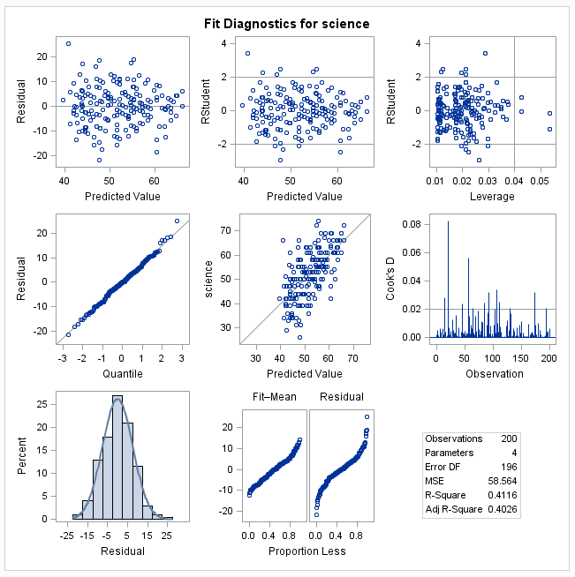

Influential Points and Assumptions!!!
Address model assumptions:

Slide 6
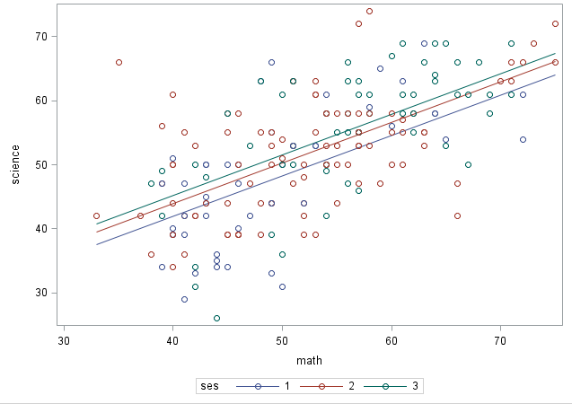
Question 1: That is, by how much can we expect the science score to increase or decrease with respect to SES = 3 (make SES = 3 the reference level). This page is for informational purposes, no questions.

Slide 7
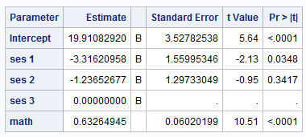
Question 1
Overall regression model:
Individual models with different intercepts based on SES value (If applicable):
Interpret significant findings:

Slide 8
Breakout 1 One Stop Here

Slide 9
Question 2
Next, we want to know if and how much the math score is related to the science score after controlling for the reading score. Be sure and write out the model statement and check assumptions!

Slide 10
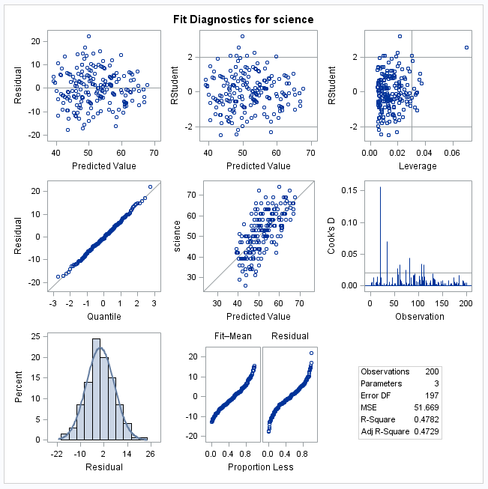

Question 2 Influential Points and Assumptions!!!
$$\hat{μ}\text{\{}\text{Science} \text{Score}\text{\} =}{ β}_{0}+β_{1}Math+β_{2}Read$$
Address all model assumptions:

Slide 11

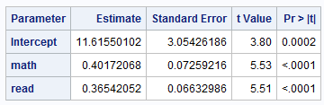
Question 2:
Write models for each parameter estimate table:
Which one is more appropriate:
Interpret any significant findings:

